Slide 1
Employee Data Analysis using Excel
STUDENT NAME: R. KalpanaDevi
REGISTER NO:122200045
NM Id :B9BF33BD0B4465F91AB4F6DCFB6A8D63
DEPARTMENT:B.com [Corporate secretaryship] 3rd year
COLLEGE: S.I.V.E.T College,Gowrivakkam.

Slide 2
PROJECT TITLE
Employee Performance Analysis using Excel
Employee gender analysis in various departments

Slide 3


AGENDA
Problem Statement
Project Overview
End Users
Our Solution and Proposition
Dataset Description
Modelling Approach
Results and Discussion
Conclusion
3/21/2024 Annual Review

Slide 4

PROBLEM STATEMENT
The project is about Employees data analysis using Excel.
Here the performance of male and female employees in various departments are analysed according to the FTE.

Slide 5

PROJECT OVERVIEW
In this project we are going to see about how the number of male and female employees are analysed according to the FTE by using Excel sheet.
With the usage of tools in Excel sheet the performance of the employees are analysed and represented in a diagrammatic representation .

Slide 6
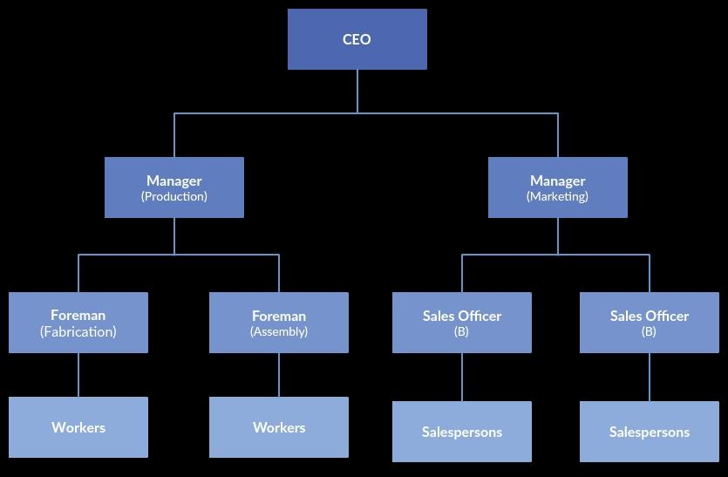

WHO ARE THE END USERS?

Slide 7

OUR SOLUTION AND ITS VALUE PROPOSITION
Features used from Excel:
conditional formatting
Filter
Pivot table
Pivot chart

Slide 8
Dataset Description
Employee dataset – From Edunet dashboard
features used from dataset
Emp ID
Name
Gender
Department
Salary
Start Date
FTE
Employee type
Work location

Slide 9

THE "WOW" IN OUR SOLUTION
Pivot table total male and female FTE analysis
3/21/2024 Annual Review
9

Slide 10
MODELLING
Data collection:
dataset downloaded from Edunet dashboard
worked with Excel.
Feature collection:
Employee ID
Name
Gender
Department
Salary
FTE
Data Cleaning:
Filter
FTE level
Pivot table: summary
Pivot chart
Visualization.
10

Slide 11
RESULTS
11

Slide 12
conclusion
By comparing performance of the employees the female employees are higher than male employees in various departments of a company. This the following company is motivating the female employees to work for their organisation.

